Slide 1
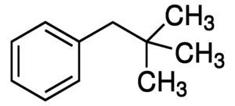
TEAM BENZENE BOTS
TRUCK PLATOONING PROJECT
TEAM BENZENE BOTS
DAWAR ZAMAN
ABDULLAH ZAFAR
MUSTAFA TOUQIR
SYED MUHAMMAD SAIM

Slide 2
Tools used
Architecture Pattern : Microservices
Programming Language: Python and JavaScript
Application Programming Interface(API) : Flask and JSON
Container service : DOCKERS
Communication Protocol : MQTT
Algorithm used(Platoon Leader) : Nearest Neighbour
Web Interface : HTML
Programming Model : CRUD

Slide 3
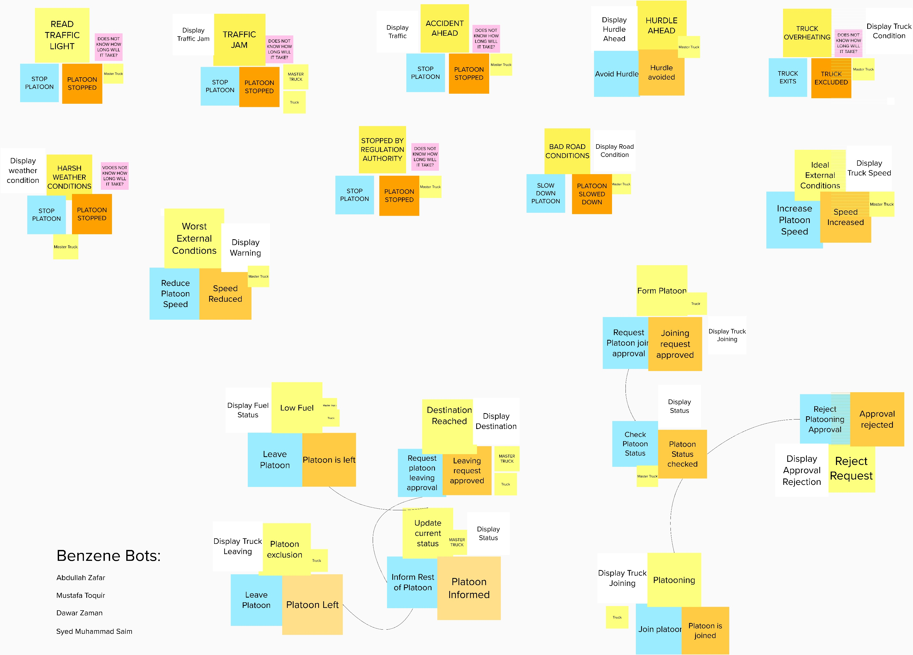

Slide 4
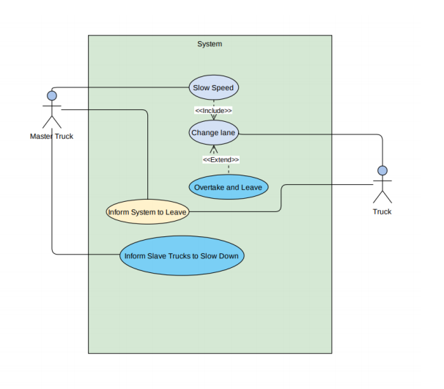
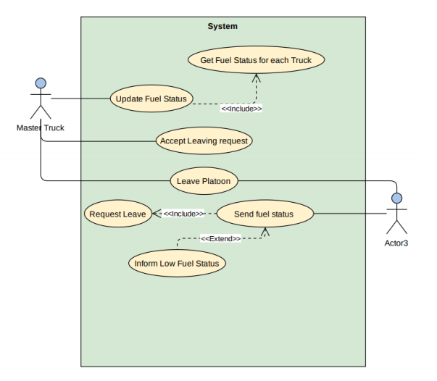
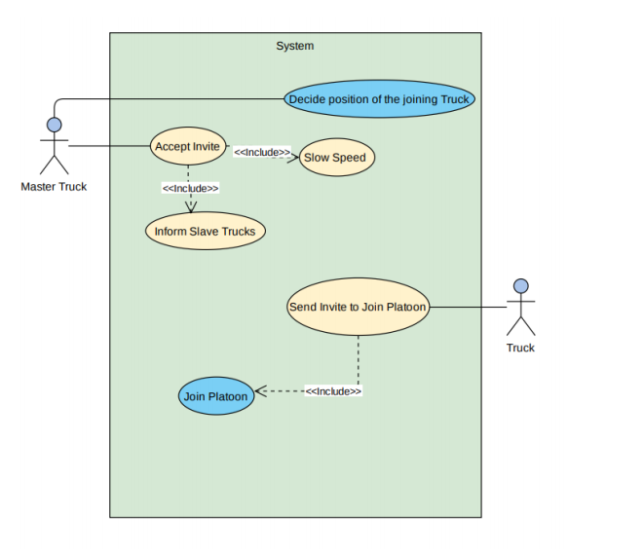
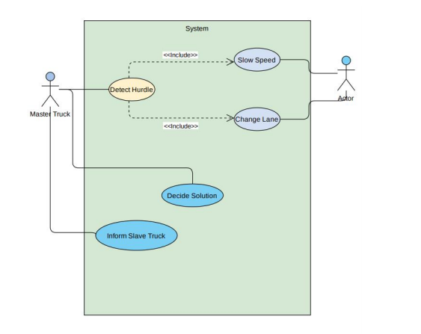
USE CASE DIAGRAMS

Slide 5
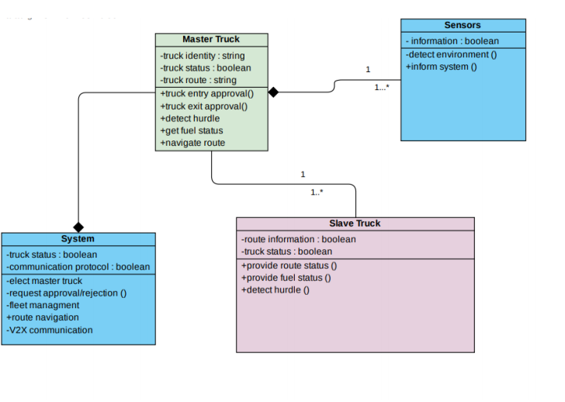
Class Diagram

Slide 6
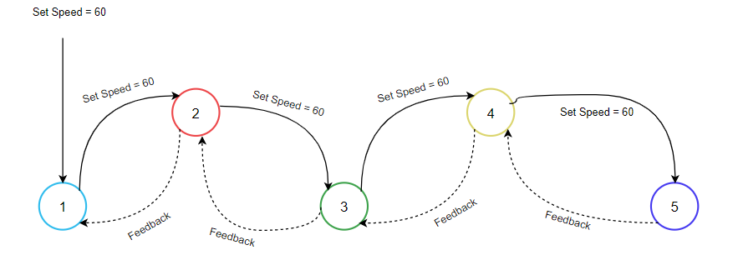
Communication Flow

Slide 7
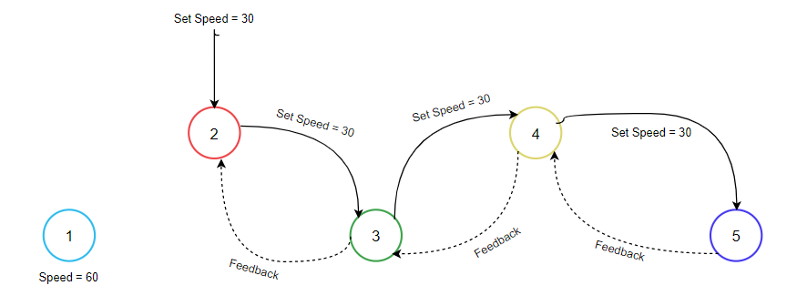
Setting Truck 2 Speed

Slide 8
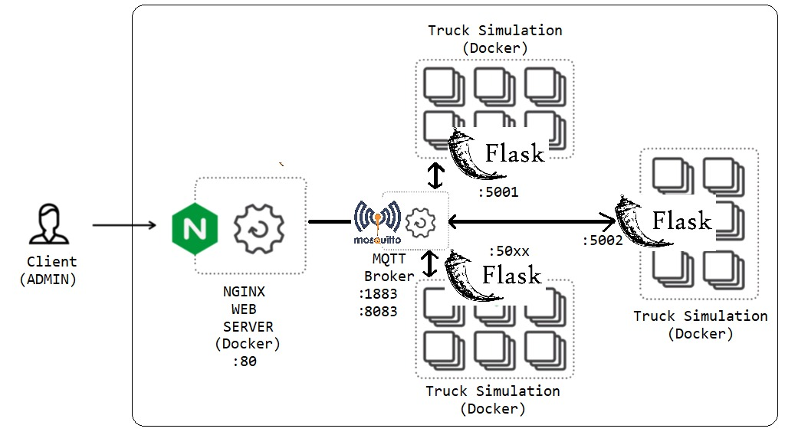
Microservice Architecture

Slide 9
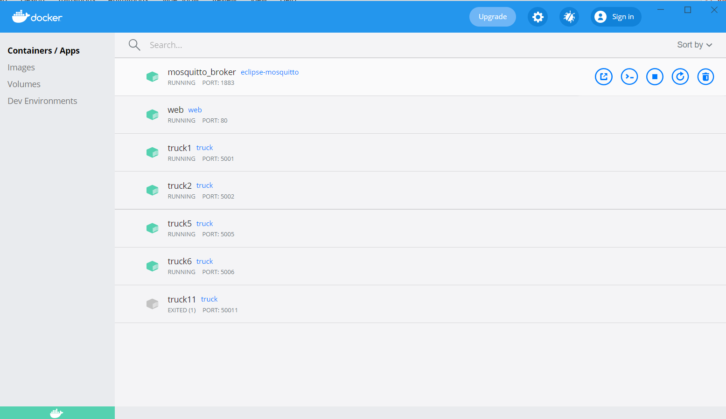

Slide 10
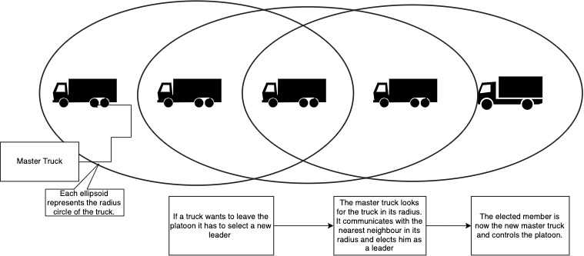
Election Algorithm(Nearest Neighbour)

Slide 11
DEMO TIME! ☺

